Slide 1
This presentation was handcrafted at the
WBTB
PowerPoint Propulsion Laboratory in Canton, MI
I said it. I meant it.
I was there to represent it.
Feel free to use all this stuff.
If you would like me to come speak to your team or facilitate a webinar for your organization, please reach out to me. It would be an honor.
TBurke@WorkByTerryBurke.com
Professional
Development
April 19, 2018
INFLUENCE WITHOUT AUTHORITY

Slide 2
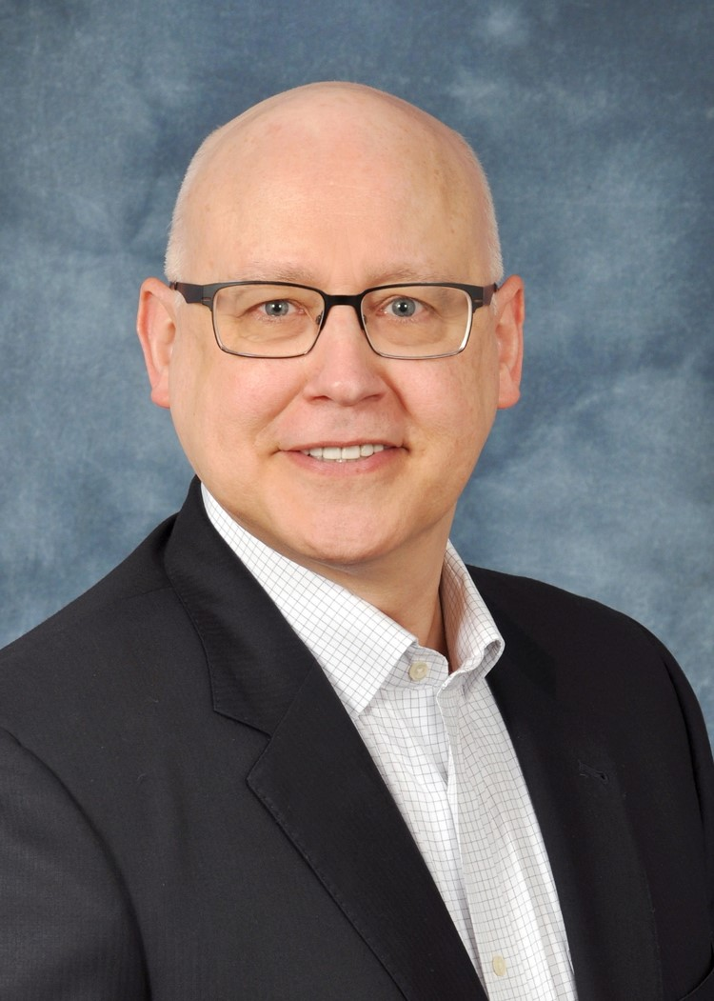
Who is this guy talkin’ at me about how to influence, anyway?
Executive of the Year 2016-2017, NMA Chapter #141
Health care executive with over 35 years of experience
Graduate, GAMA International Essentials of Leadership Program
General Electric Financial Services Leadership Excellence Program
Personalized Leadership Development Program through The Leadership Trust
Leadership Development Program, Center for Creative Leadership
Certified Trainer, Managing Goal Achievement and Integrity Selling
Blue Cross Executive Facilitator in Mentoring Circles Program
Leading Through Change
Communicating Up to Leadership
Preparing for Next Level Leadership
Terry Burke
Vice President & Segment Leader
Blue Cross Blue Shield of Michigan

Slide 3
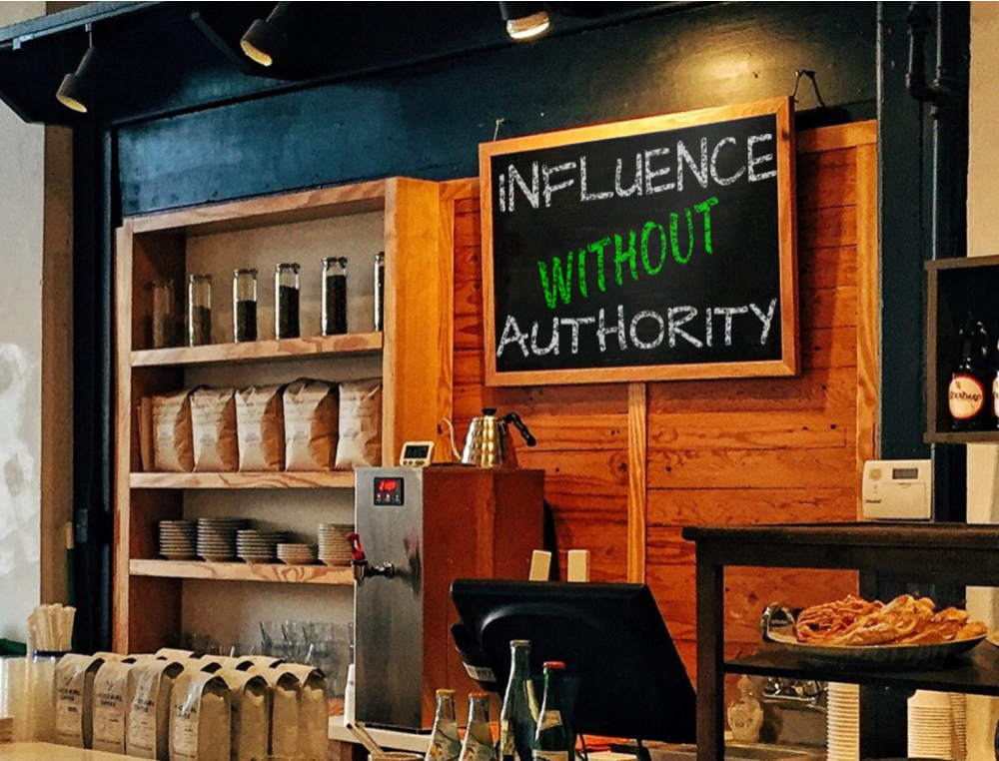
NMA Cafe

Slide 4
of
INFLUENCE
L E A D E R
The
WITHOUT AUTHORITY IS A HOT TOPIC
IN ORGANIZATIONS TODAY
MORE AND MORE WE ARE ALL BEING ASKED TO BECOME SERVANT LEADERS

Slide 5
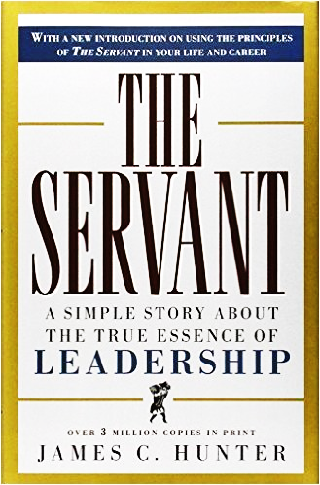
Here’s Our Starting Point for Today
“
Everything you need to know about leadership you already know…
…be the boss you wish your boss would be, the parent you wish your parent had been more fully for you, the neighbor you wish your neighbor would be.
Today, I am not here to instruct you. Today, I am here to remind you.
James C. Hunter
Author of The Servant
”

Slide 6
The Simple Definition
LEADERSHIP
The skill of influencing people to work enthusiastically toward goals identified as being for the common good.
Simply put, leadership is about getting things done through people.

Slide 7
BE ONE OF THEM. LEAD ALL OF THEM.
YOU DO IT WITH INFLUENCE…
I am an
IWA
leader
…NOT WITH AUTHORITY. BUT HOW?

Slide 8
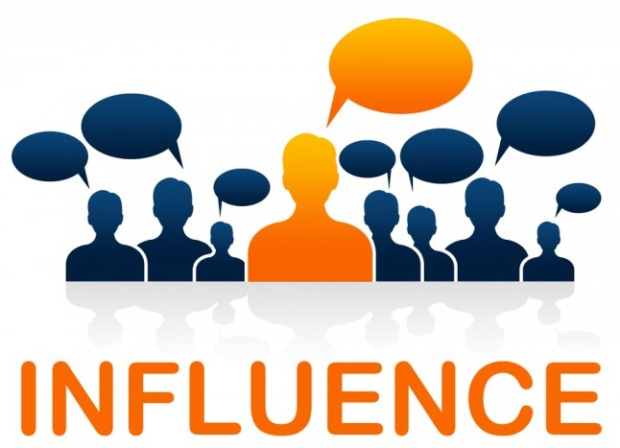
WHAT I’LL
DO HERE
TODAY
G R O W
Yourself
Your career
Others
PRACTICAL
TIPS
I CAN USE
REFERENCE
MATERIALS
SHOW
ME HOW TO GROW
EXAMPLES
BOOKS
HOW?
HELP
You
Must
WALK the WALK
You can KNOW ABOUT influence. But you have to KNOW influence.
YOU have to practice this. You have to put in the work.

Slide 9
I’m
THE BOSS.
Just do what I tell you and get it done!!!
Back in the “good old days,” if you were in a position of authority, you could just announce what needed to be done and assume it would be carried out.
Times have changed.

Slide 10
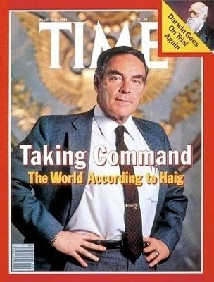
My
OPINION
March 30, 1981
Reagan Shot
The good old days are gone
Hierarchy creates
dependency
Authority breeds
mediocrity
Leading without formal
authority is a high skill
Influence without authority supports mutual objectives and mutual respect
“As of now, I am in control here of the White House”

Slide 11
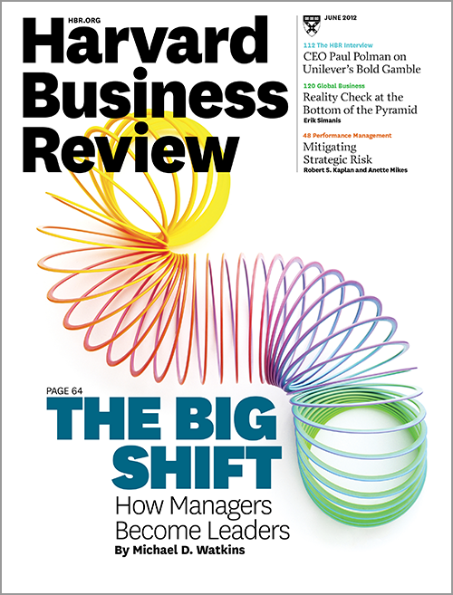
“
In order to engage in a conversation about leadership, you have to assume you have no power, that you aren’t in charge of anything and that you can’t sanction those who are unwilling to do your bidding.
If, given this starting point, you can mobilize others and accomplish amazing things, then you’re a leader.
If you can’t, well then, you’re a bureaucrat.
”
May 2013

Slide 12
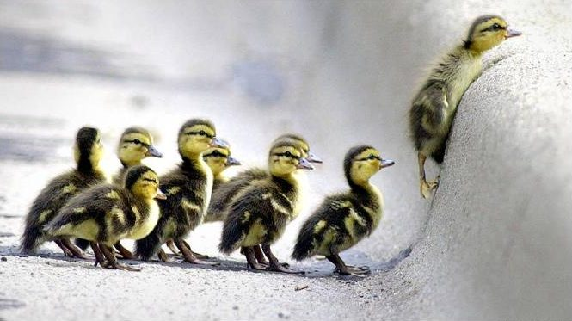
Leadership is a VERB…
As defined in James Hunter’s THE SERVANT
THE SKILL OF INFLUENCING PEOPLE TO WORK ENTHUSIASTICALLY TOWARDS GOALS, IDENTIFIED AS BEING FOR THE COMMON GOOD, WITH CHARACTER THAT INSPIRES CONFIDENCE

Slide 13
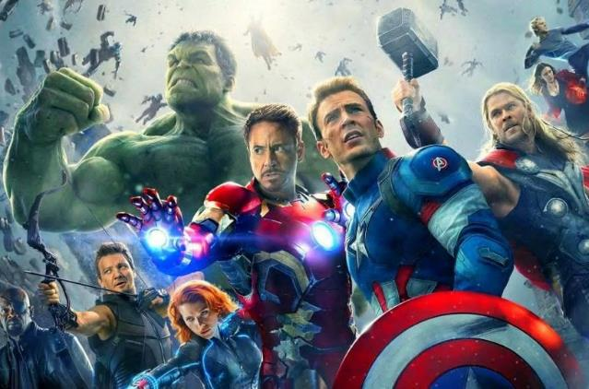
IWA MEANS MEETING THE
LEGITIMATE NEEDS OF PEOPLE YOU’D LIKE TO WORK WITH YOU
Make sure your AVENGERS
have everything they need to be successful and win
How can I lead?
How can I become and advocate and influence others?
How do I keep going?
What renews and invigorates my motivation?
What’s in it for me?
Why am I motivated?
What can I do?
What specifically are you asking of me?
CREATE A TEAM OF ALL LEADERS WITH DIFFERENT RESPONSIBILITES
YOU ARE CAPTAIN AMERICA
FIRST AMONG EQUALS
Where do I fit in?
Why do I care about the vision?
Your Vision and Goal
What’s your WHY - Start with WHY

Slide 14
THE DNA OF A RELATIONSHIP COMES DOWN TO KNOWING…
WHAT IS IMPORTANT
Positive
Emotions
Having
a Voice
Trust
Honesty
Mutual
Respect
Personal
Growth
Service
to Others
Something Bigger
than Me
WHAT DRIVES PEOPLE TO ACT

Slide 15
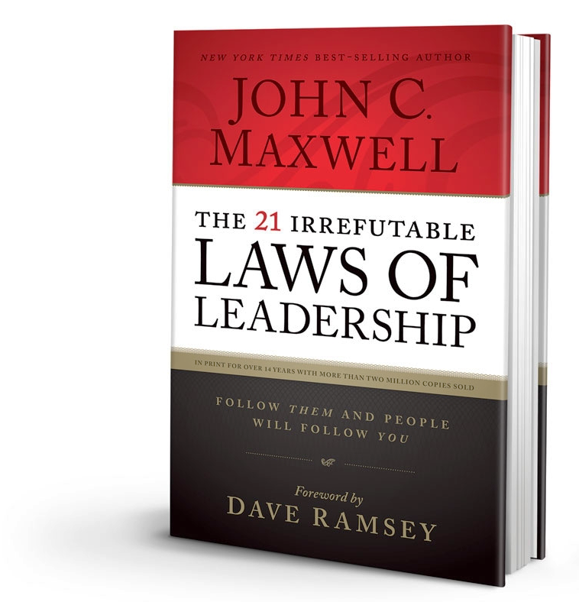
Law #2
The Law of Influence
The true measure of leadership is influence.
Nothing more, nothing less.

Slide 16
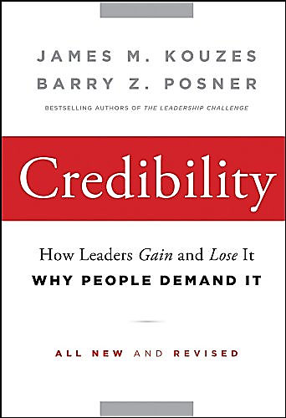
You Don’t Know Me.
You Just Met Me.
Why Should You Believe Me?
Many books have been written on
IWA
by many experts.
BELIEVE
THEM
Kouzes-Posner
First Law of Leadership
If you don't believe in the messenger, you won't believe
the message.

Slide 17
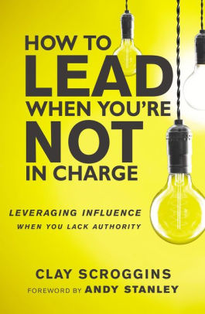
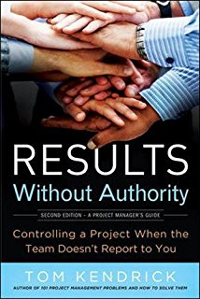
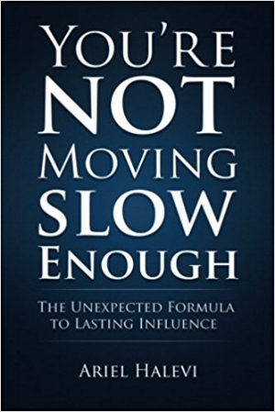
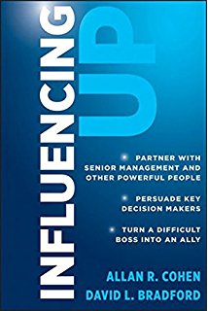
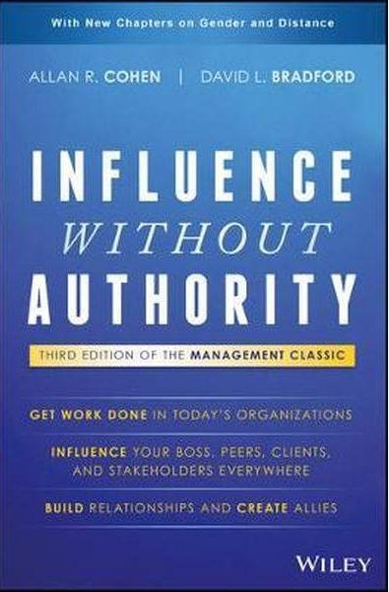

Slide 18
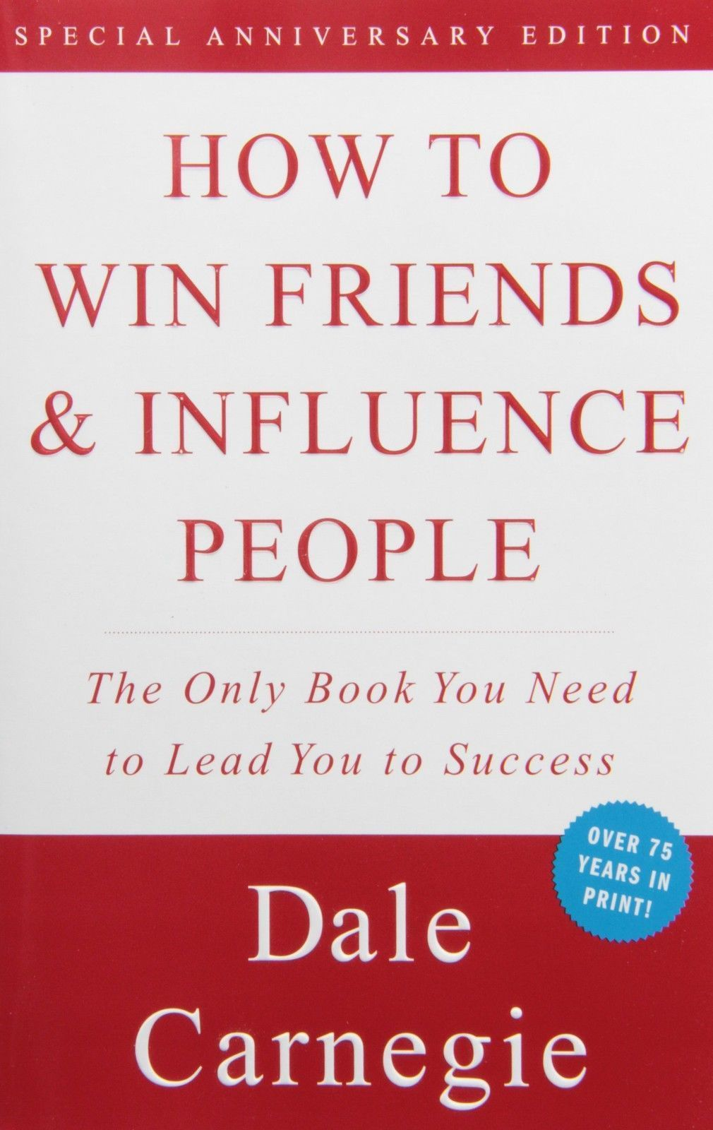
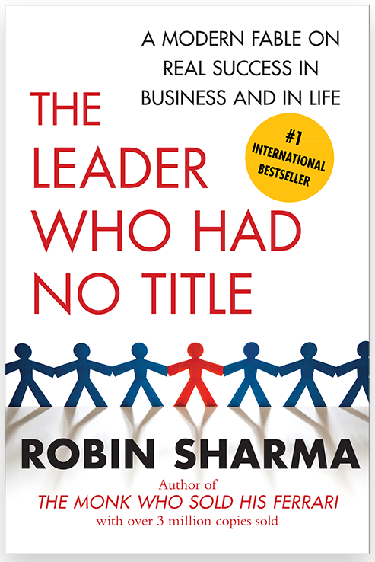
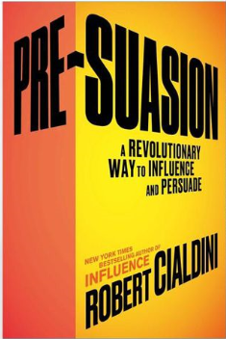
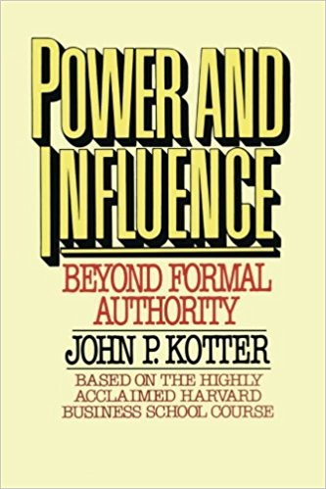

Slide 19
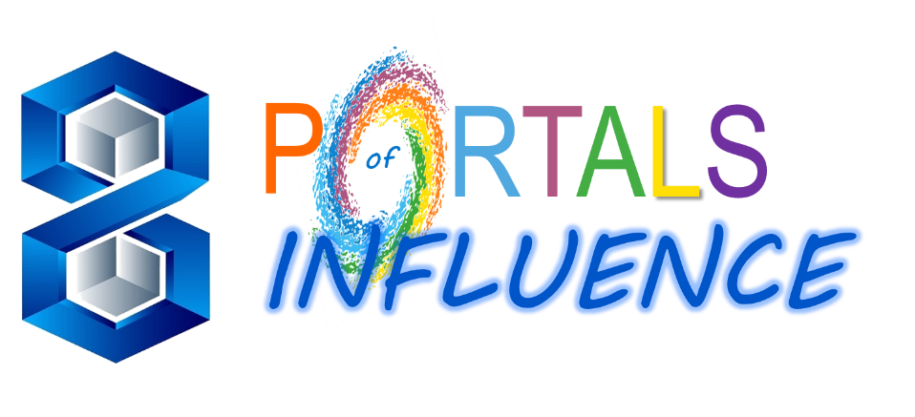
WAYS TO INFLUENCE WITHOUT AUTHORITY
Let’s take a look at one model

Slide 20
P
RTALS
of
INFLUENCE
Connectedness
Networking
Character
Information
Collaboration
Funding
Expertise
Social
Intelligence

Slide 21
Character
Do you lead by example and follow through on your commitments? Are
you respectful, authentic and trustworthy?
The First Four Portals
Expertise
Do you have content knowledge and experience? Are you a thought leader? Do you understand the process needed to accomplish the objective?
Ask Yourself These Questions
Information
Do you have access to valuable information? If not, do you know who does?
Connectedness
Do you form close relationships with people? Do they enjoy working with you? Do you engender loyalty?

Slide 22
Social intelligence
Do you offer insight into interpersonal issues that interfere with work and help facilitate resolution of issues?
Network
Do you put the right people in touch with each other? Can you garner the endorsements of credible people?
The Last Four Portals
Ask Yourself These Questions
Collaboration
Do you seek win-win solutions, unify coalitions and build community?
Funding
Do you have access to financial support? Can you build an ROI case?

Slide 23
Build your muscles
before you need them
Don’t rely on only one source of influence; when it doesn’t work you have no fallback position
Example: If you always influence through the logic of expertise, you will have little impact on those who are more responsive to someone they have a personal connection with
When you develop more of these portals, you have more options
And, you have the opportunity to step back and consider which is the best portal for a particular situation

Slide 24
There’s a difference
between influencing and
driving an agenda
If you are too attached, you are less likely to be heard. At some point, if you have done your best and have not been successful, you need to let it go.
There are no guarantees
When we move away from authority-based leadership, not all efforts to influence will be successful
Failing to influence does not mean you made a mistake
It might have been a good idea but the wrong time
When we shift from authority-based to influence-based leadership, we have to accept that we are not always in control
However, the reality is that we actually never were.
Good ideas
Careful planning
Smart people
No Guarantee that it all works out and your are a successful influencer

Slide 25
Now let’s look at an Oscar winning movie to provide 3 lessons learned regarding
INFLUENCE
WITHOUT AUTHORITY
THE KING’S SPEECH
NMA
Webinar
A
W
I
BURKULES
Productions
presents

Slide 26
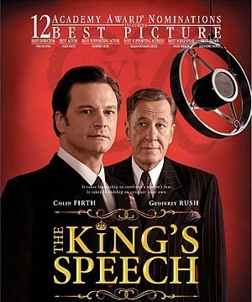
The King’s Speech
How to Influence without Authority
The Gist for Our Purposes
The King's Speech is a movie about the relationship between the stammering King George VI of England and his speech therapist, Lionel Logue.
An extraordinary friendship develops between the two men, as Logue uses unconventional means to teach the monarch how to speak with confidence.
So, what does this
have to do with
leadership development?

Slide 27
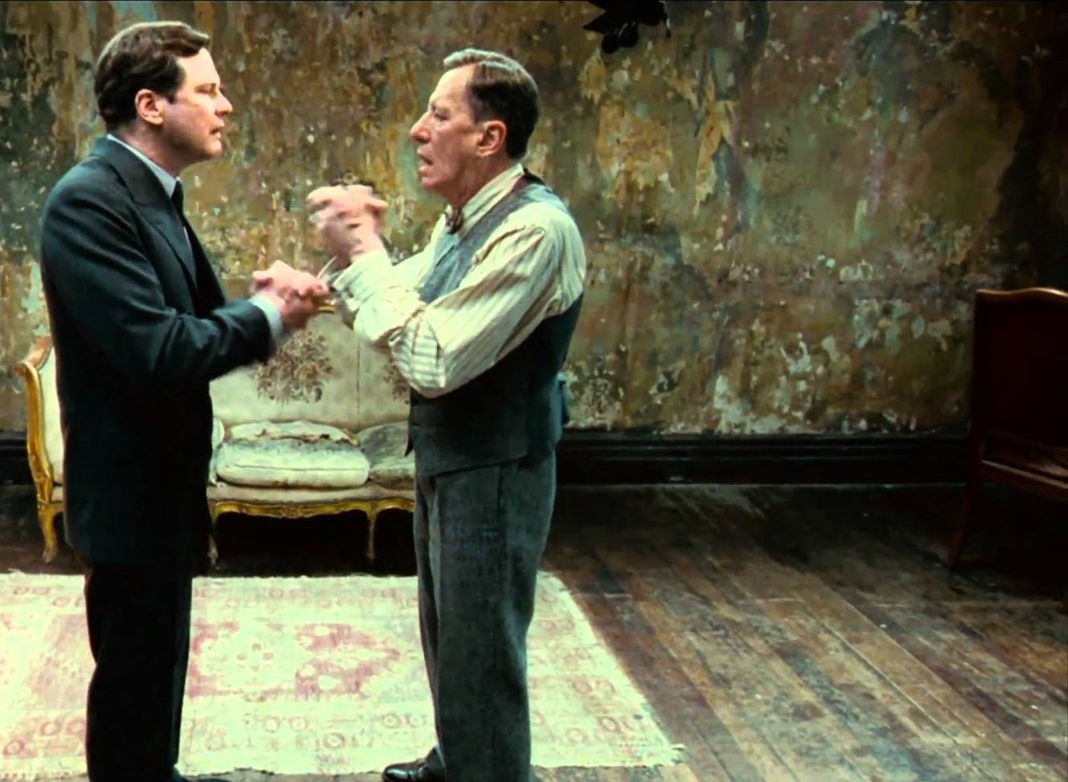
Although he eventually becomes the king’s trusted advisor, Lionel doesn't begin the relationship that way.
He has little to recommend the King, since neither his credentials nor his social status give him instant credibility.
The disparity in their births, culture (Logue was Australian), and breeding is daunting.

Slide 28
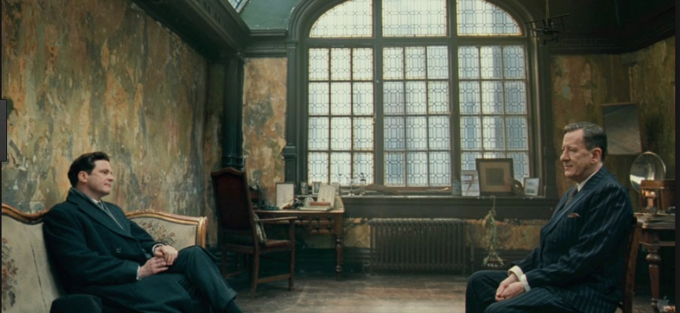
So how is this commoner able to help the monarch and become his life-long friend
?
I
N
F
L
U
E
N
C
E
W
I
T
H
O
U
T
A
U
T
H
O
R
I
T
Y
He is a master at influencing
with absolutely no authority

Slide 29
INFLUENCE WITHOUT AUTHORITY
Three Lessons
Learned from
The
King’s
Speech

Slide 30
I W A
Lesson #1
To influence without authority we need to establish trust.
Three Lessons from The King’s Speech
Lesson #2
To IWA we need to support the decision-makers with our advice.
Lesson #3
Respect, authenticity, and empathy help us to IWA.

Slide 31
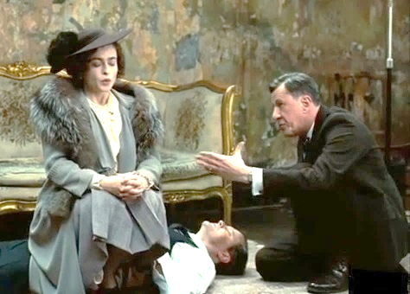
To influence without authority we need to establish trust
Lesson
#1

Slide 32
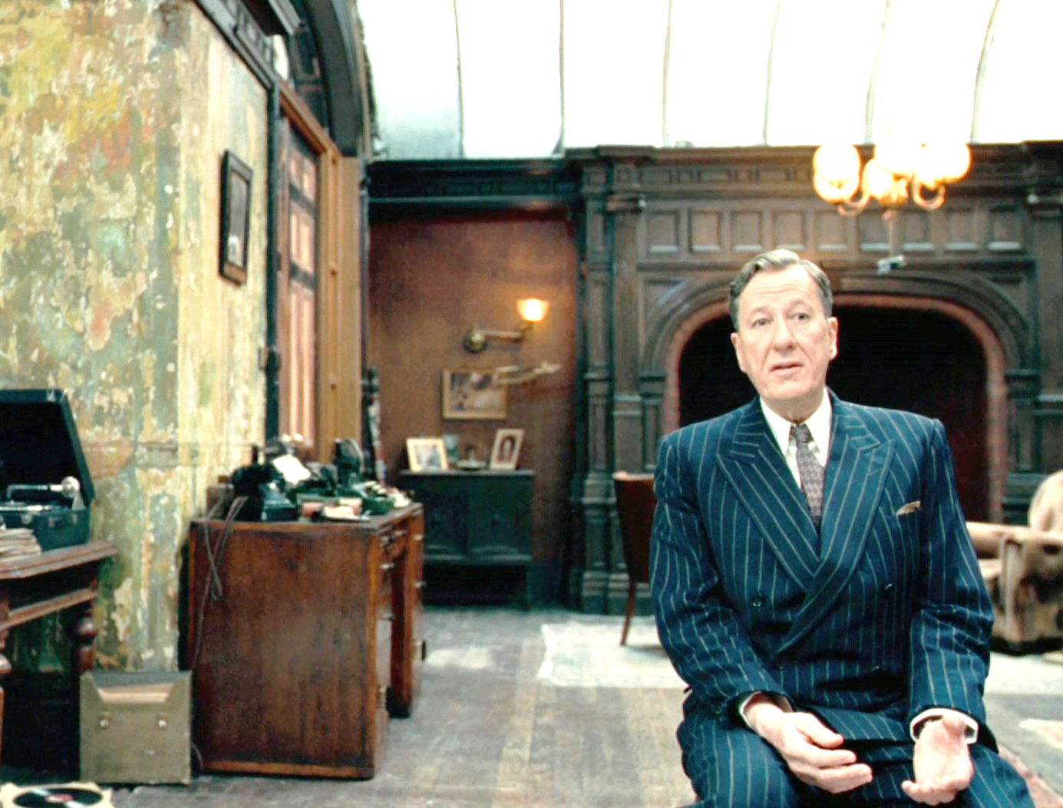
We need to support the decision-makers with our advice
Lesson #2
IWA

Slide 33
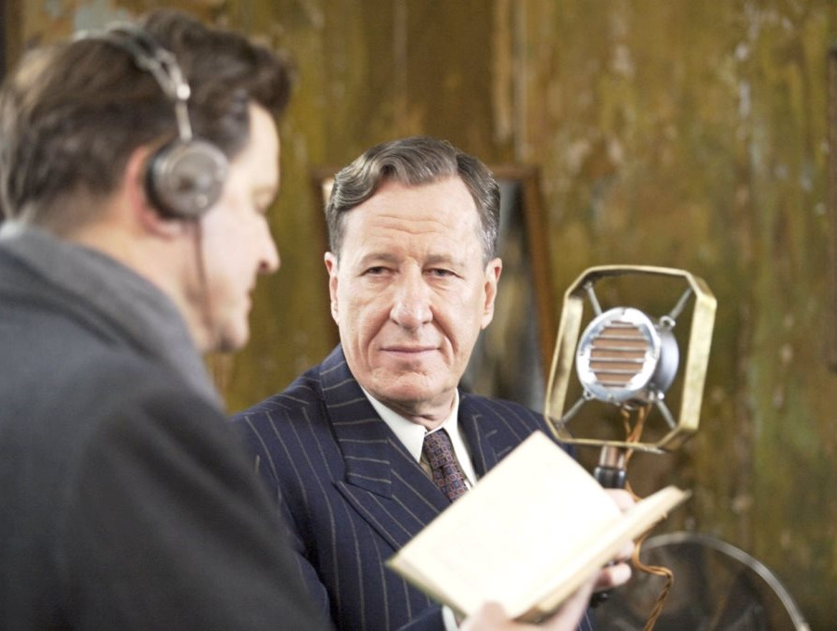
Respect, authenticity, and empathy help us IWA
Lesson #3

Slide 34
KING’S
SPEECH
The
KING’S
SPEECH
Lesson #1
Establish trust.
Lesson #2
Support with our advice.
Lesson #3
Respect, empathy and authenticity.
CHARACTER
COLLABORATION
EXPERTISE
INFORMATION
SOCIAL INTEL.
CONNECTEDNESS
NETWORKING

Slide 35
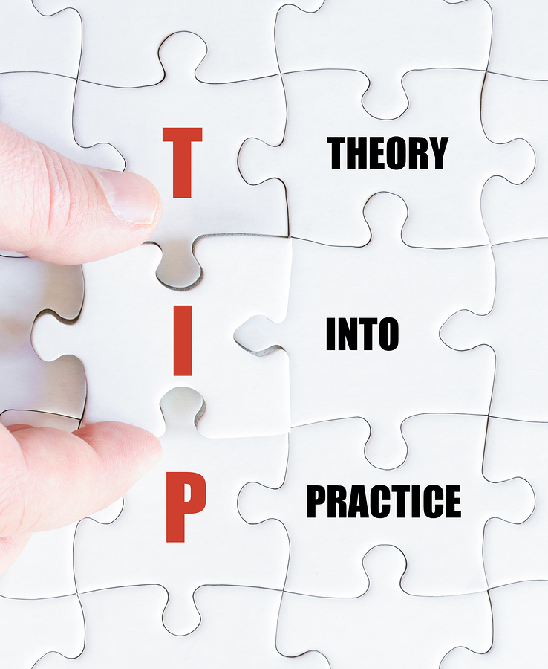
Let’s Turn Leadership and Influence Theory into Practical Practice You
Can Run With
Burke’s
IWA
TIPS
for
NMA

Slide 36
Common Situation
You are asked to lead or project manage a major initiative.
Success depends on many people across many disciplines, none of whom report to you.
KICKOFF
Meeting

Slide 37
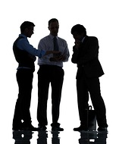
Common Situation
The Dreaded Meetings AFTER the Meeting
“She doesn’t have the experience to run this. For this to get done we will just have to work around her.”
“There’s no way I’m doing all that work.
I don’t report
to her.”
“Who’s decision was it to put her in charge of this?”
“He had some good ideas but nobody got the opportunity to suggest alternatives.”
“See, look at his data.
It just doesn’t make sense.”

Slide 38
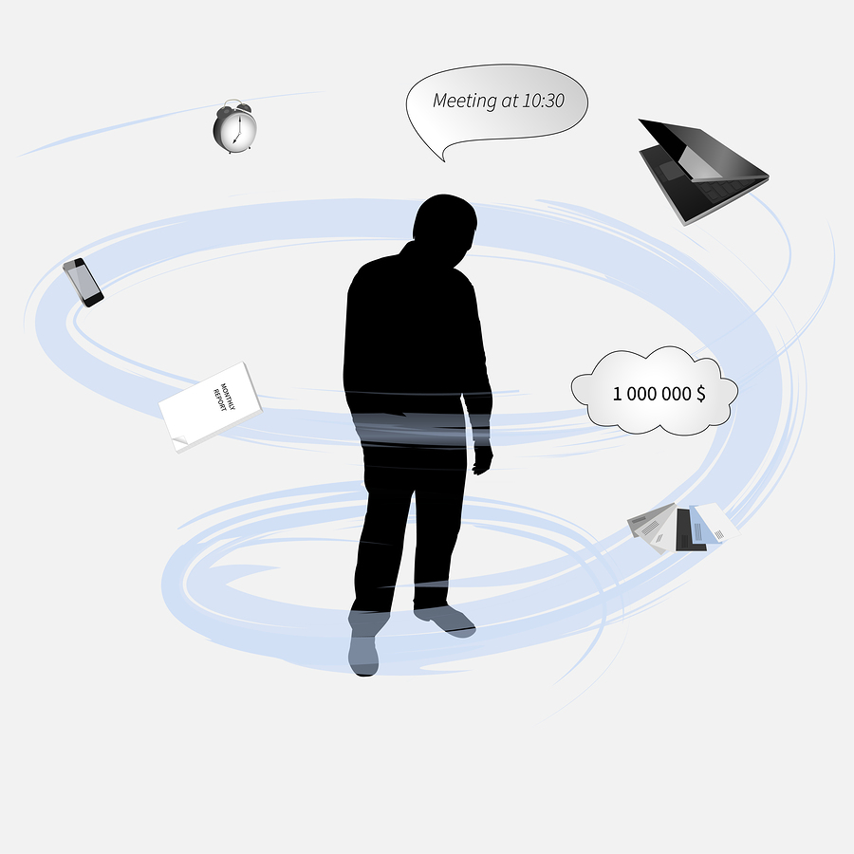
Common Situation
You are herding cats and trying to get
out in front of all the backchanneling
This used to be YOU
YOU
Exhausted
Frustrated
Defeated
What happened?
What do I do?

Slide 39
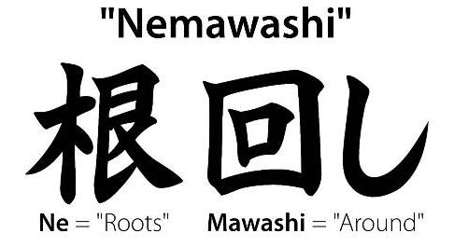
NEMAWASHI
It is how you
INFLUENCE
WITHOUT
AUTHORITY
Literally translated as ‘going around the roots’, particularly in the sense of digging around the roots of a tree to prepare it for transplant.
Nemawashi means laying the groundwork or foundation; building consensus.

Slide 40
At my company, Blue Cross Blue Shield of Michigan,
this is one of our seven enterprise core beliefs
Consensus-building
Getting people on the bandwagon
Obtaining buy-in
Sending up a trial balloon
Testing the waters
Getting on the same page
Greasing the skids
Behind the scenes persuasion
Influencing without authority the Nemawashi way means preparing for success and growth.
You may know this process by many informal names and phrases.
N
E
M
A
W
A
S
H
I

Slide 41
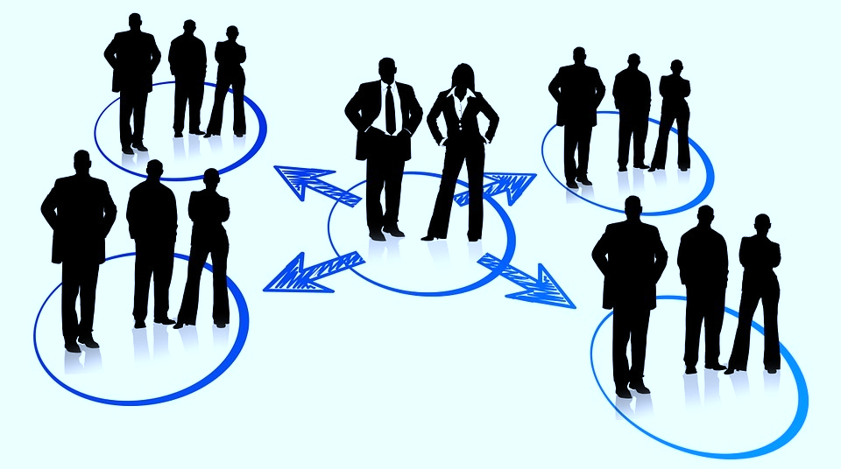
IWA Successfully When You NEMAWASHI
You took the time to have the Meetings BEFORE the Meeting
Investing time on the front-end created alignment and collaboration, opened new relationships and networks, and built momentum

Slide 42
The frustration of the Meetings After the Meeting
Becomes the Influence with The Meetings BEFORE The Meeting
Influence without authority

Slide 43
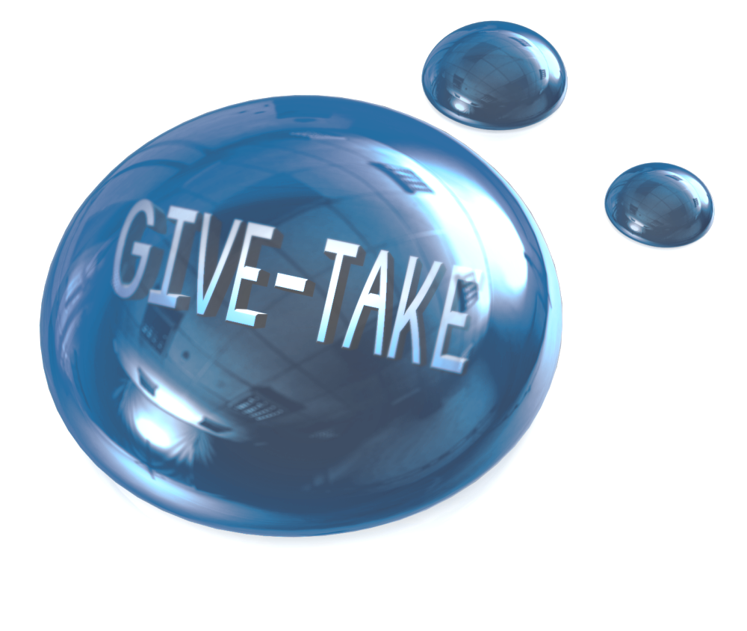
INFLUENCE WITH OUT AUTHORITY
Assume all are potential allies
Cohen-Bradford
Model
1
Get crystal clear on your priorities and goals
2
6
INFLUENCE
through
Diagnose the world of the other person
3
Identify relevant currencies, both yours and theirs
4
5
Cultivate and grow your relationships
Let’s look at some examples that Model the Way…

Slide 44
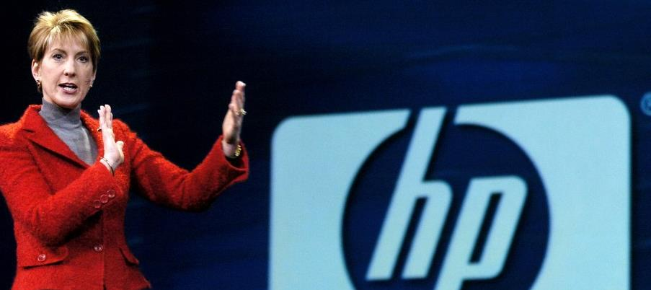
1
Assume all are potential allies
CARLY FIORINA
Former CEO of HP
“The highest calling of leadership is to unlock the potential of others”
Named to Time 100
“most influential people.”
At one time was a receptionist at a real estate brokerage
BE ALIGNED. Say to yourself that “anyone at anytime can help me meet our objectives.”

Slide 45
2
Get crystal clear on your priorities and goals
HOWARD SCHULTZ
Starbucks founder
You will get turned down too. Be clear on your goals and others will follow and join in.
Schultz was turned down 242 times for a bank loan to start his company

Slide 46
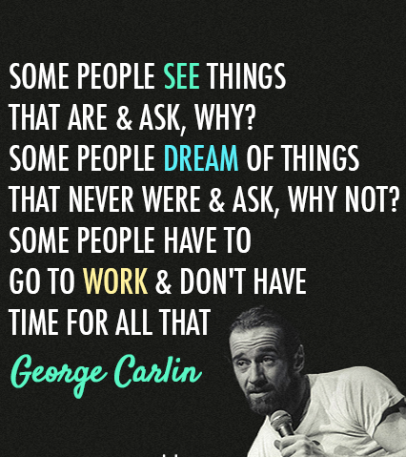
3
Diagnose
the world of the other person
We are all volunteers in flatter org structure world.
Be sensitive to the demands that others already have at work.
SEE & DREAM for them at the start. Then momentum builds.

Slide 47
“
Remember that it’s always about other people.
Learn to build up and encourage everyone around you.
Letting other people know that they matter and that you recognize how valuable they are frees them to reach new heights.
A person who feels appreciated will always do more than what is expected.
”
Ann Marie Campbell
Home Depot EVP
Started as a cashier
Identify relevant currencies, both your and theirs
What do others care about?
Find out, align and grow together through using Portals of INFLUENCE
4

Slide 48
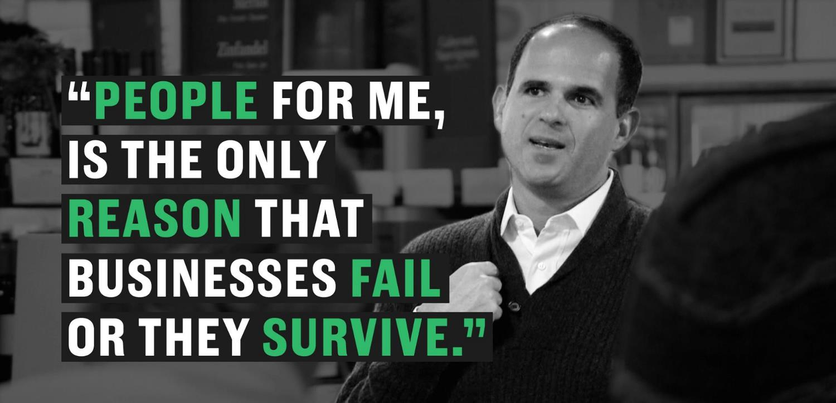
5
Cultivate and grow your relationships
MARCUS LEMONIS
Serial Entrepreneur
Be like Lemonis.
Use YOUR INFLUENCE to build relationships to grow you, them and the work product.
Uses INFLUENCE to grow people and their businesses

Slide 49
IWA Success Requires
INFLUENCE
through
GIVE and TAKE
WHY HELPING OTHERS DRIVES OUR SUCCESS
It turns out that at work, people operate as takers, matchers, or givers.
Takers strive to get as much as possible from others
Matchers aim to trade evenly,
Givers are the rare breed of people who contribute to others without expecting anything in return.
GIVE
TAKE
Which one are you?
When you can identify these personas your INFLUENCE and SUCCESS will SOAR
ADAM GRANT

Slide 50
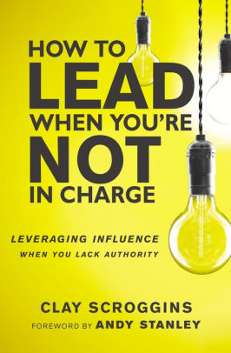
“Great leaders leverage influence and relationships over title and position.”
“Leaders don’t sit back and point fingers. Leaders lead with the authority of leadership . . . or without it. The authority is largely irrelevant—if you are a leader, you will lead when you are needed.”
“The best leaders lead like they’re not in charge even when they are.”
TOP 5 QUOTES
“Influence has always been, and will always be, the currency of leadership.”
“The more challenging the conversation, the more private it should be.
Challenge privately. Champion publicly.”

Slide 51
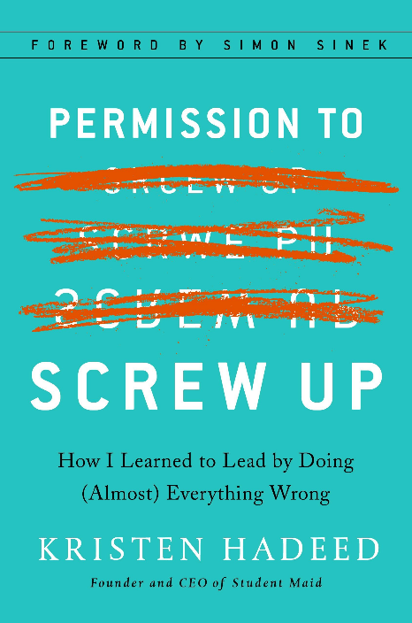
One Last TIP
Theory into Practice
from Burke
You Have Permission To SCREW UP
Leadership is a Verb
Influence is a Skill
Both can be learned
Both are a choice
You have to put in the work
Go ahead…
Screw Some Stuff Up
It will make you
a Great Leader

Slide 52
How can you be one of those people?
SPEAK in such a way that others love to LISTEN to you
LISTEN in such a way that others love to SPEAK to you

Slide 53
Reinforce the IWA Learning
Bradford –Cohen Model in Action
I have no authority over you but believed that I can influence you – leadership is influence
I Nemawashi-ed to gain alignment with NMA in my preparation
As an experienced leader and lifelong learner, I think I am able to diagnose your world and have “walked a mile in your shoes”
We have some similar currencies in our careers, which help you build trust, confidence and integrity
Hopefully we built a rapport here
and the information resonated
Lastly, I commit to continue
to dialogue with all of you
GIVE & TAKE
I came today believing all of you are allies, interested in growth and development of self and others
My goals and objectives were crystal clear, as was my role for todays session
YOU
BURKE

Slide 54
Time
for
Q&A
on
IWA
for
NMA
Terry Burke
VP and Business Segment Leader
Blue Cross Blue Shield of Michigan
TEBurke@bcbsm.com

Slide 55
IWA
FOLLOW THE LAW
Maxwell’s Law of Influence
FIRST YOU MUST SERVE
Hunter’s The Servant
WALK THE WALK
Cohen-Bradford 6-Steps
GET QUIET WITH YOURSELF
The voices of judgement, doubt, fear
BE YOUnique
Lead from who YOU are and
where YOU are in your organization
TERRY’s TOP 5
TAKEAWAYS INFLUENCE WITHOUT AUTHORITY
I threw a lot at you in an hour.
Here’s the GIST of my views.

Slide 56
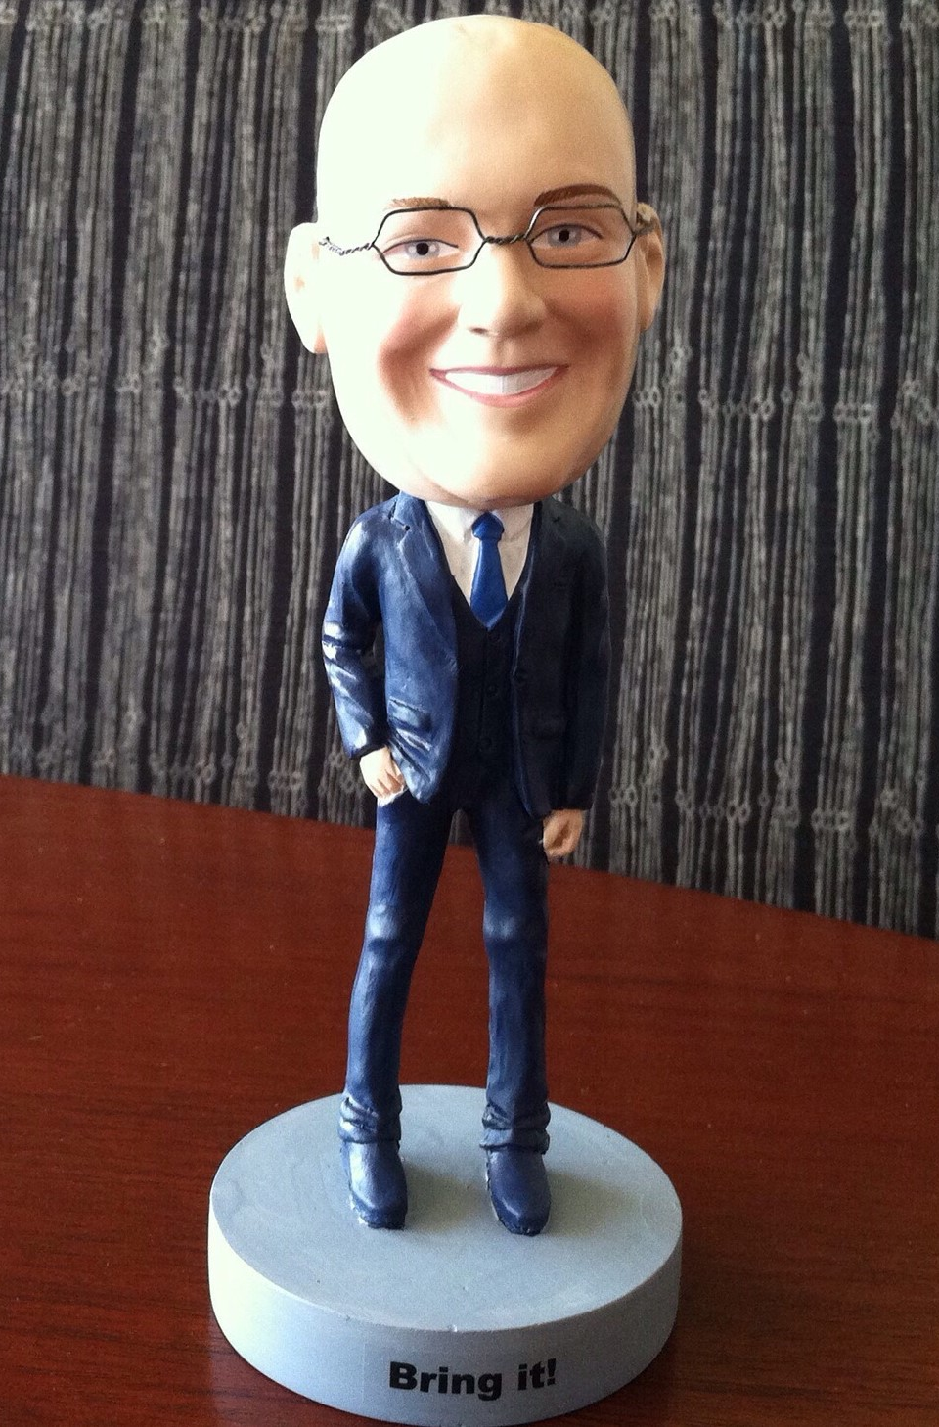
At Your Service
I delivered this presentation in April 2018 while running a business segment for Blue Cross Blue Shield of Michigan.
Since that time I have retired as a “corporate guy” and have been spending some time as a Strategic Advisor for several healthcare startups and collaterals as well as venture capital firms focused on the healthcare sector.
I have done several speaking engagements - I write my own stuff, do my own slides, every show is customized to that audience.

